Slide 1
Welcome to Kindergarten
Welcome to the Brooksbank Kindergarten
2024/2025 School year

Slide 2
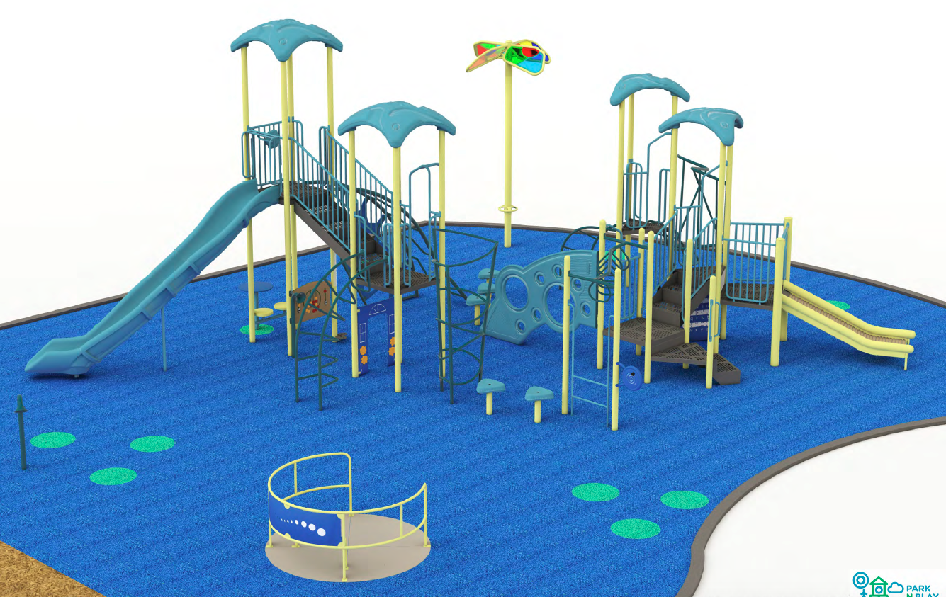
Playground

Slide 3
Code of Conduct
Compassion in our
thoughts, words, and
actions

Slide 4
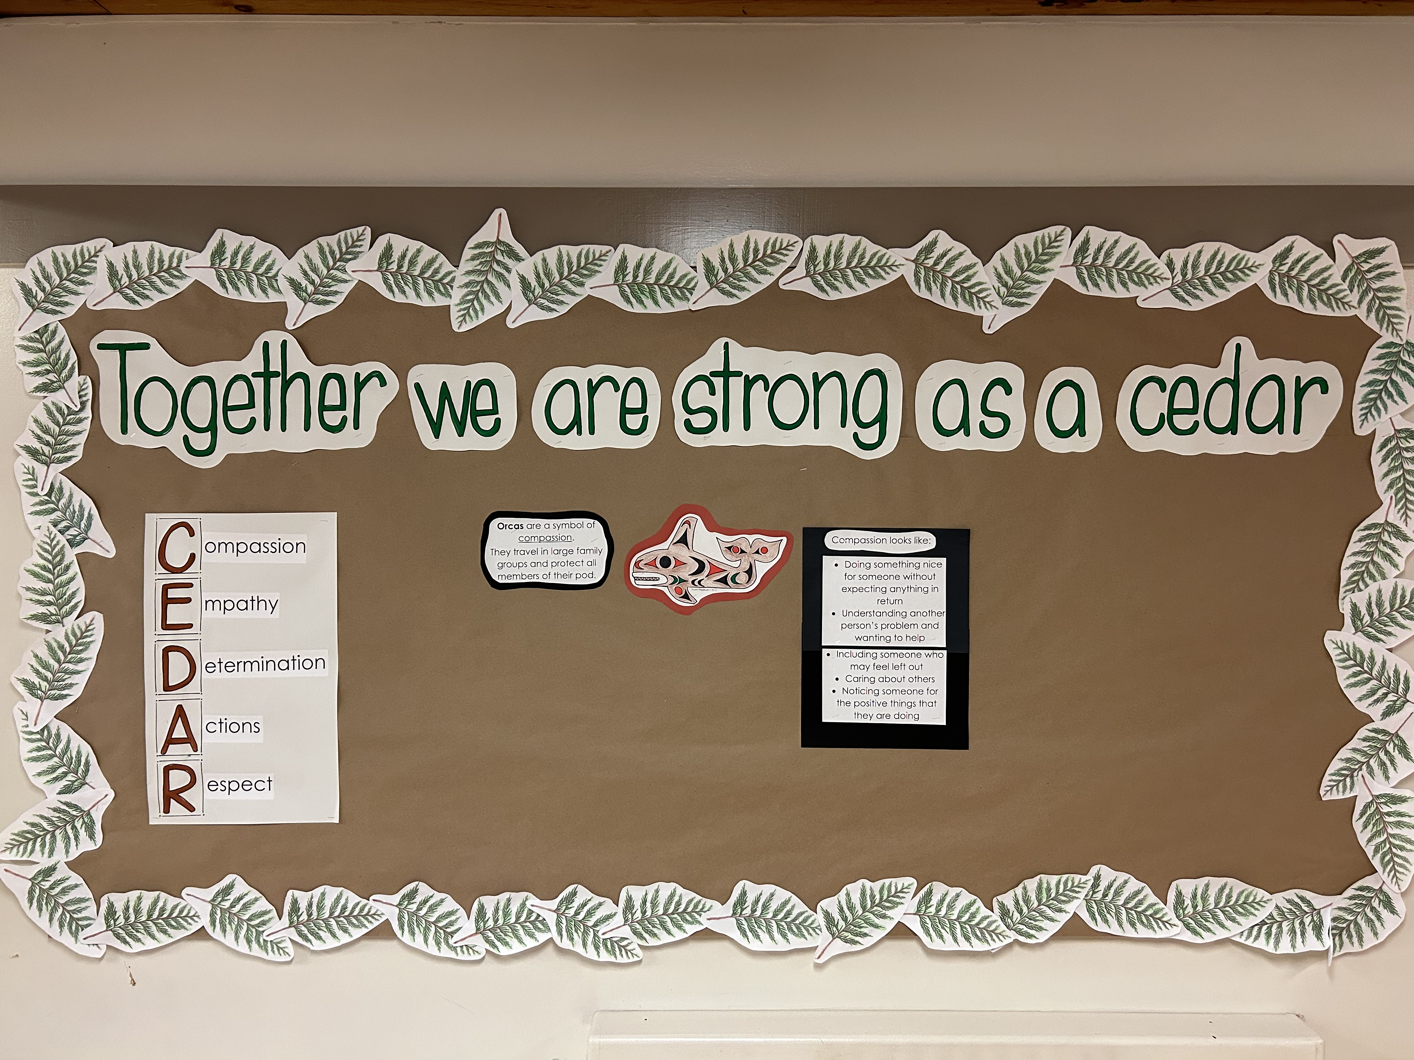
Together we are strong as a CEDAR

Slide 5
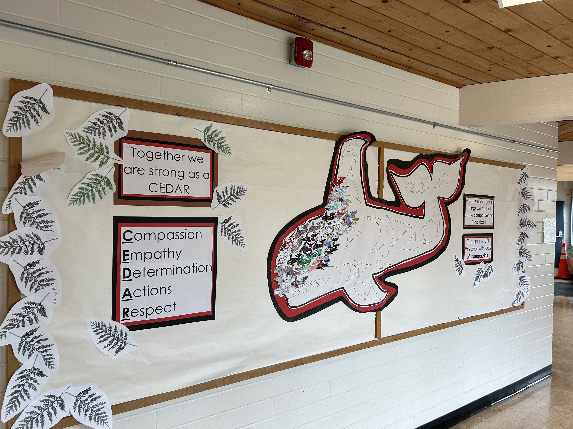
PBIS

Slide 6
Student Belonging
Extra curricular opportunities: sports teams, concerts, clubs
Student Council –Grade 7
Multi-age activities – Fun Day, Earth Day, Buddy class
Student led lunch monitors
Orange Shirt Day –September, Pink Shirt Day-February
Kilometer Club
Jump rope for Heart

Slide 7
School Information
Traffic
Visitors/Volunteers
Forms
Supplies
School Fees- $65 cover all school supplies
        -possible extra cost for field trips

Slide 8
Communication
School website
MS Teams -classroom
Emails/newsletters/school messenger
Absence-Safe arrival
PAC email

Slide 9
Getting Ready for Kindergarten
Routines
Provide opportunities for independence
Toileting, shoes, coats, etc
Explore letters and numbers in your daily life
Bedtime routine, morning routine
Vision/hearing/dental screening done at the Kindergarten level

Slide 10
Independence
I can/I am learning to:
Put on/ take off my coat (with zippers, buttons, etc)
Take items in/out of backpack
Eat my lunch (open/close containers/packages)
Go to the bathroom (use independently)
Wash my hands
Put on/fasten my shoes and jackets
Clean up after myself (play time, eating time)

Slide 11
Peers
Practice taking turns
Practice sharing
Play-parallel and interactive
Practice talking and listening with peers

Slide 12
With an adult
Enjoy stories, songs and rhymes
Explore letters, sounds, numbers and new ideas
Explore different ways to create
Engage in household jobs
Play games (taking turns)

Slide 13
Curriculum
Play based
Focus on Social Emotional Learning
Language-receptive and expressive (communication)
Physical development and well being
Academic-strong literacy and numeracy focus (phonological awareness, getting ready to read and write)

Slide 14
Student Placement
Age-balanced
Preschool experience
Information provided by care givers/questionnaire

Slide 15
Gradual Entry
Students visit school on different days/times
Staff work with small groups of learners
Establish routines, expectations of school
Provides opportunities to get to know the students in a school setting
Allows staff to adjust class placements when necessary

Slide 16
Supervision
In the classroom during lunch
Playground-”K’ area for the first month or more (Pink/Red)
Washrooms-close proximity to the classrooms
Monitors-grade 6/7 peers

Slide 17
Hours
8:46 am start
10:20-10:40 recess –snack in class after outside play
12:10 pm lunch- play first, then eat
12:57 pm afternoon classes begin
3:00 pm dismissal (Monday, Tuesday, Thursday, Friday)
Wednesday 2:00 pm dismissal
Students are outside rain/shine

Slide 18
Preparation
Labels in all clothing, bags and belongings
Water bottle
Extra clothing, shoes

Slide 19
CHEQ-Childhood Experiences Questionnaire

Slide 20
The CHEQ Asks parents and caregivers about:
Physical Health & Well-Being
Their child’s experiences related to physical health and overall well-being including daily physical activities, routine health care check-ups, nutrition and sleep habits.
Language & Cognitive
A variety of experiences that influence their child’s language development and cognition, including reading, storytelling, engaging in conversation and pretend play, rhyming, using pens and pencils, counting and sorting, painting and more.
Social & Emotional Experiences
Different social experiences their child may have had before Kindergarten, including playing with other children, sharing and helping others. In addition, parents/caregivers are asked about opportunities their child may have had to talk about their emotions and the emotional experiences of others.
Early Learning & Care
Their child’s experiences in non-parental care arrangements and preschool, as well as challenges faced when looking for care. They are also asked about their child’s experience with intervention programs and supports.
Community & Context
Their perceptions of neighbourhood safety, opportunities for children to play outside in their neighbourhood, social support networks and whether neighbours can be counted on to look after children.

Slide 21
The PAC
Who are we?
Parent Advisory Council
The PAC EXEC is made up the following:
Co- Chairs: Jackie Mather and Erin Barker
Co-Vice Chairs: Sukhpal Dulay & Kate Bingham
Secretary: Elizabeth Novak
Treasurer: Rob Shaw

Slide 22
PAC
The majority of us are currently in our first year of term, and are allowed a maximum of 2 consecutive years (in the same position) on the Executive.
Every parent/care giver of Brooksbank are also MEMBERS of the PAC and can attend meetings, volunteer, vote, make suggestions, etc!

Slide 23
What do we DO?
Support opportunities to build community and raise funds to help the extra curricular needs of the school. Last year the goal was to raise money for new iPads.
Each year the staff make a wishlist which is presented to the PAC, then we try our best to meet the needs of the wishlist.
Our BIGGEST fundraiser is FUN LUNCH on Thursdays through MUNCHALUNCH. Each student will get access to create MUNCHALUNCH account.
Other fundraisers include events such as the Jingle Mingle (Christmas Jingle Shop and games) and Picnic in the Park (Silent Auction, BBQ, Cake Walk, Spin to Win, Scavenger Hunt) as well as Online Fundraisers: Purdys, Plant Sale, Charcuterie & Beer & Wine, Coffee Sales, Cobs Bread, Two Rivers Meats, etc . . .

Slide 24
Where to find us:
PAC Chair Email: bbpacchair@gmail.com
Treasurer Email: bbpactreasurer@gmail.com
PAC WEBSITE: http://brooksbankpac.weebly.com/
Fun Lunch Coordinator Email: brooksbankfunlunch@gmail.com
Instagram: @Bbpac2022
FACEBOOK GROUP: Brooksbank Families https://www.facebook.com/groups/204074666382782

Slide 25
PAC Meetings
Monthy Meetings via ZOOM usually Tuesdays @ 7:30 pm and they last anywhere from 30 – 45 mins with fun Giveaways!
We also have Class Reps in each division who relay information from the PAC to the classes.
Welcome to Brooksbank! We have an AWESOME School Community who totally show up for each other, who know how to help out and definitely have fun!

